Slide 1
Study Mate – Campus Study Group Finder
Project Update Presentation
Aicha Musfaou
March 2026

Slide 2
Problem Statement
The Problem:
Students struggle to find classmates to study with
Difficulty coordinating schedules for group study sessions
Target Users:
College Students
Group Organizers

Slide 3
Modifications from Original Plan
Development Approach Changes:
Backend development started later than originally planned
Adopted frontend-first approach before backend integration
Technology Stack Updates:
Supabase chosen for database integration and authentication
Real-time features enabled through Supabase capabilities
Impact on Timeline:
Core features prioritized to maintain project schedule
Integration phase extended for thorough testing

Slide 4
Proposed Features
User Registration & Login
Campus email verification
Course-Based Group Discovery
Search by course, professor, keyword
Create & Manage Study Groups
Capacity limits, editable info
Notification System
Session reminders and updates
Group Messaging
Real-time chat with history
Scheduling & Calendar Integration
Availability matching
Location & Room Suggestions
Rating & Review System
1-5 star ratings

Slide 5
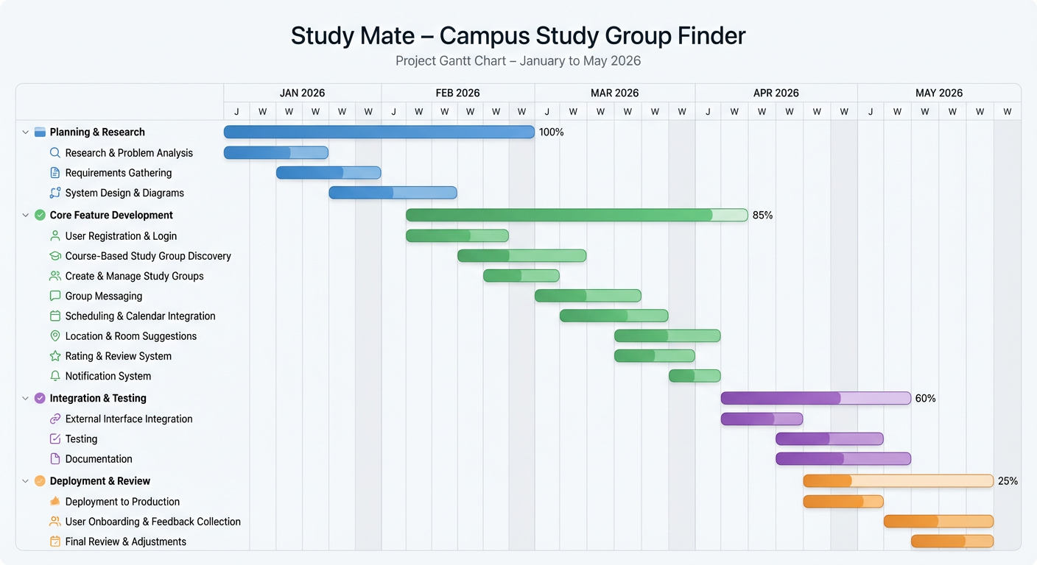
Progress Tracking – Gantt Chart (Jan–May 2026)

Slide 6
Completed Features
Completed
Landing page UI with dark theme
Navigation bar and buttons
Create Account and Login functional
Student Dashboard layout
Active Groups, Courses, Ratings display
Backend setup and database structure
Authentication logic preparation
Full Supabase Backend Integration

Slide 7
Database & Authentication Complexity (Supabase)
Challenge: Implementing a secure, real-time infrastructure for study group messaging and campus email authentication was more complex than using a simple local database.
Solution: Integrated Supabase (PostgreSQL) to handle scalable data storage and Row Level Security (RLS). This ensured that only verified students can access specific study groups, meeting the security requirements in the SRS.

